Slide 1
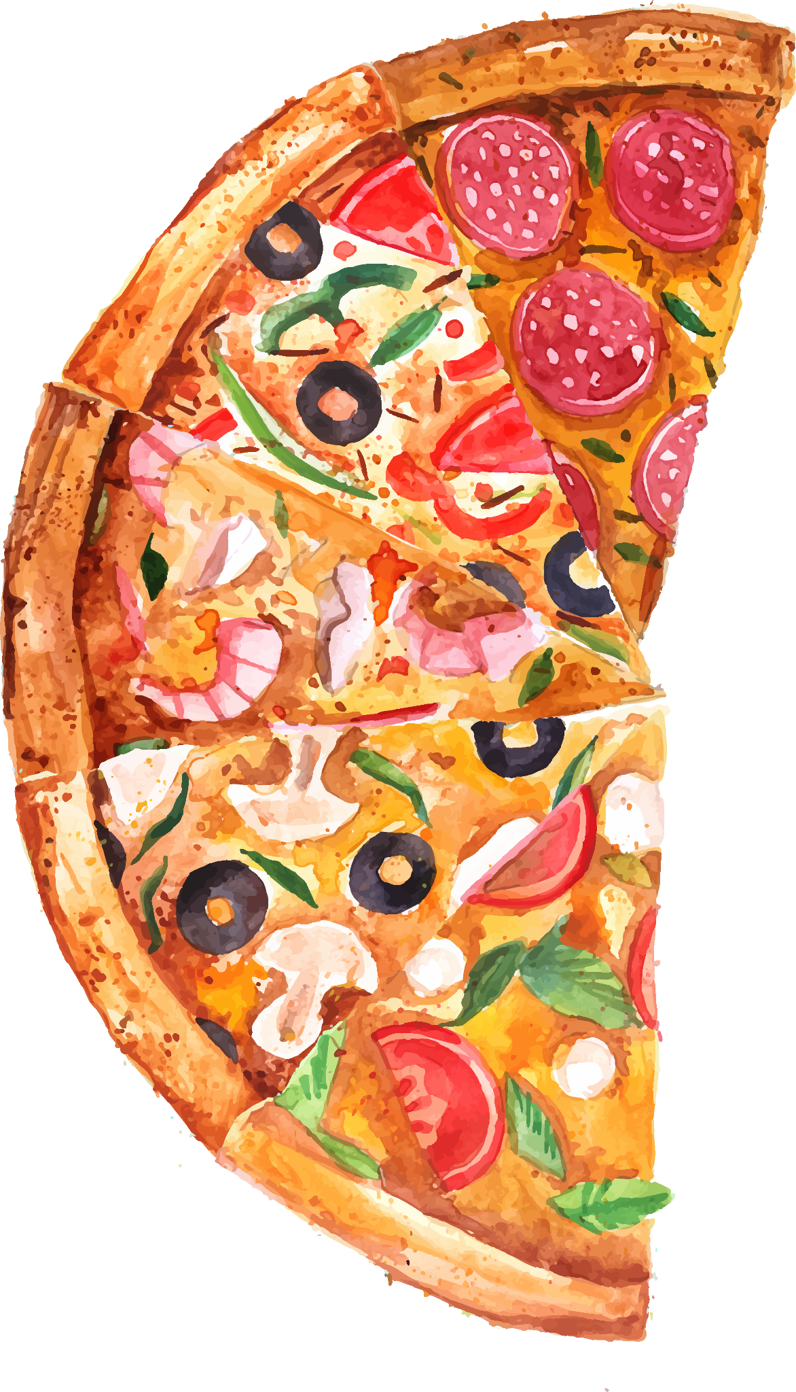
PIZZA

Slide 2
PIZZA DATASET ANALSIS USING MY SQL
BY: Manoj Pentapati

Slide 3
About Dataset
Tables Used
TABLE NAME | Column Names in Table | Total Rows
ORDERS | order_id,order_date,order_time | 21350
ORDERS_DETAILS | order_details_id,order_id, pizza_id, quantity | 48620
pizzas | pizza_id, pizza_type_id, size, price | 96
pizza_types | pizza_type_id, name, category, ingredients | 32

Slide 4

01
Basic Queries

Slide 5
Queries
01
Basic
Retrieve the total number of orders placed.
Calculate the total revenue generated from pizza sales.
Identify the highest-priced pizza.
Identify the most common pizza size ordered.
List the top 5 most ordered pizza types along with their quantities.

Slide 6
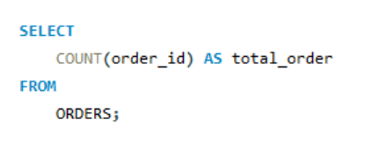
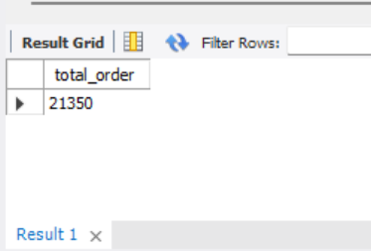
Retrieve the total number of orders placed.

Slide 7
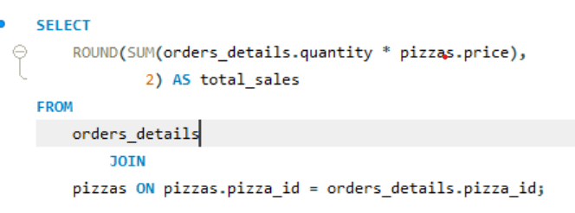
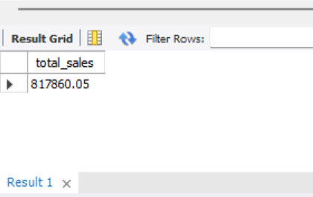
Calculate the total revenue generated from pizza sales

Slide 8
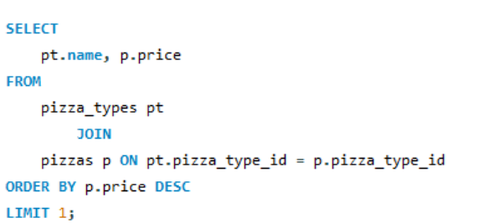
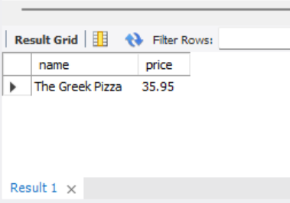
Identify the highest-priced pizza.

Slide 9
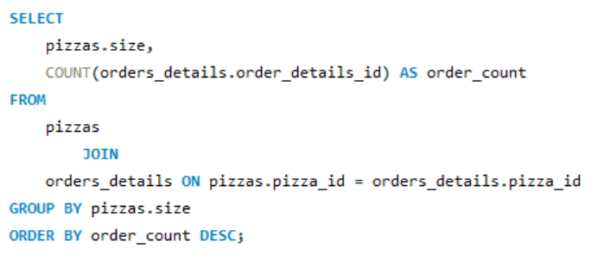
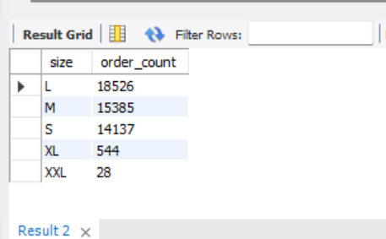
Identify the most common pizza size ordered

Slide 10
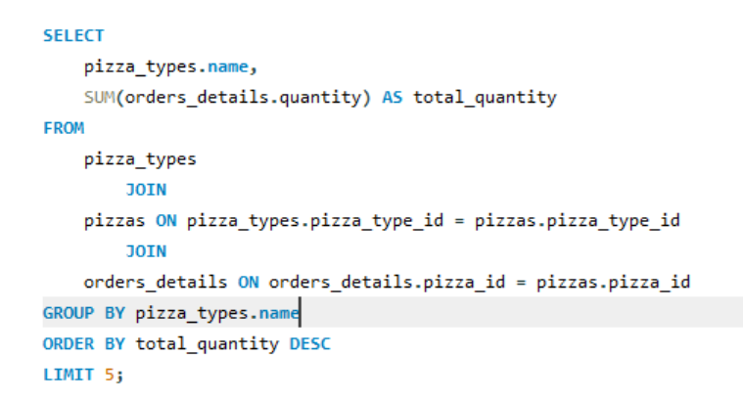
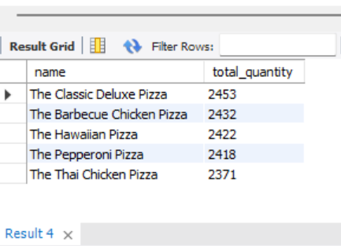
List the top 5 most ordered pizza types along with their quantities.

Slide 11

Intermediate Queries

Slide 12
Queries
02
02
03
Intermediate
Join the necessary tables to find the total quantity of each pizza category ordered.
Determine the distribution of orders by hour of the day.
Join relevant tables to find the category-wise distribution of pizzas.
Group the orders by date and calculate the average number of pizzas ordered per day.
Determine the top 3 most ordered pizza types based on revenue.

Slide 13
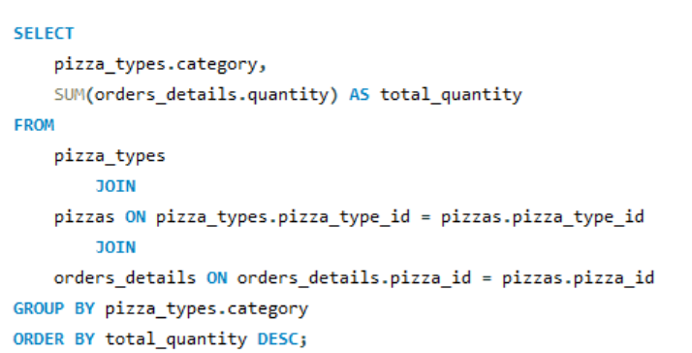
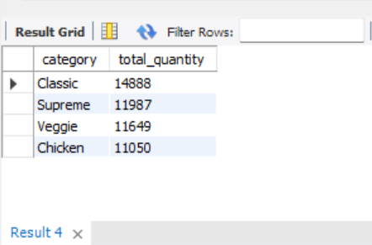
Join the necessary tables to find the total quantity of each pizza category ordered.

Slide 14
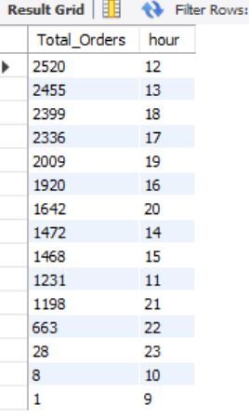
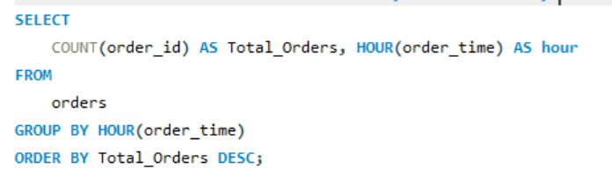
Determine the distribution of orders by hour of the day.

Slide 15
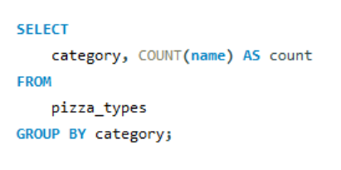
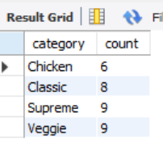
Join relevant tables to find the category-wise distribution of pizzas.

Slide 16
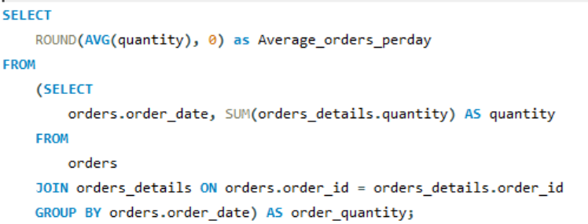
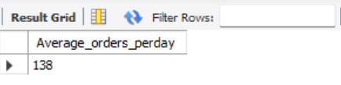
Group the orders by date and calculate the average number of pizzas ordered per day.

Slide 17
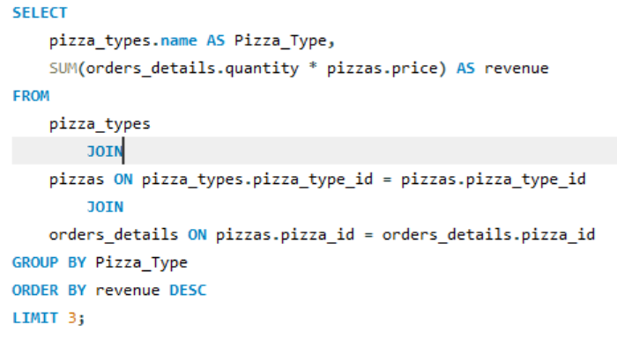
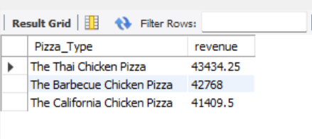
Determine the top 3 most ordered pizza types based on revenue.

Slide 18

Advanced Queries

Slide 19
Queries
03
03
Advanced
Calculate the percentage contribution of each pizza type to total revenue.
Analyze the cumulative revenue generated over time.
Determine the top 3 most ordered pizza types based on revenue for each pizza category.

Slide 20
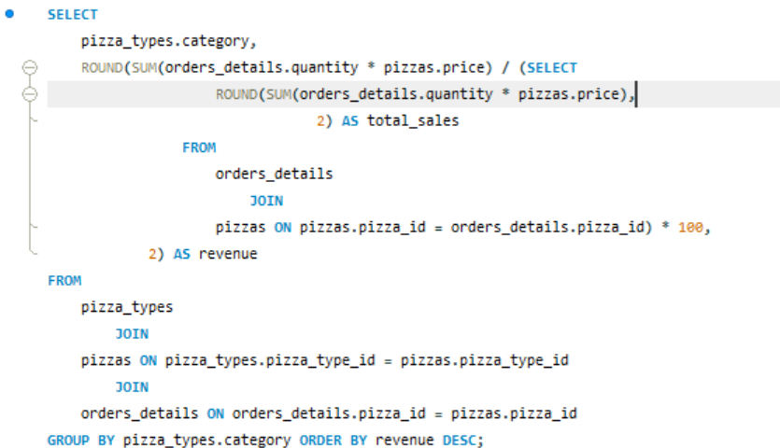
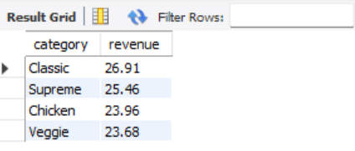
Calculate the percentage contribution of each pizza type to total revenue.

Slide 21
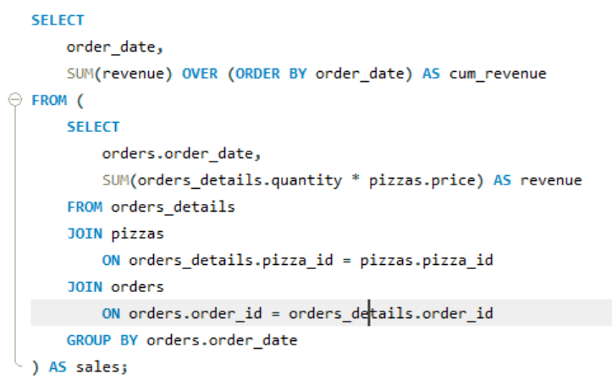
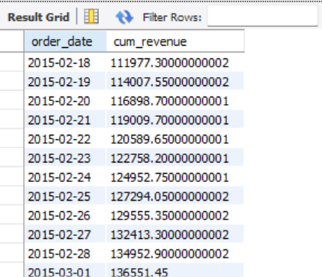
Analyze the cumulative revenue generated over time.

Slide 22
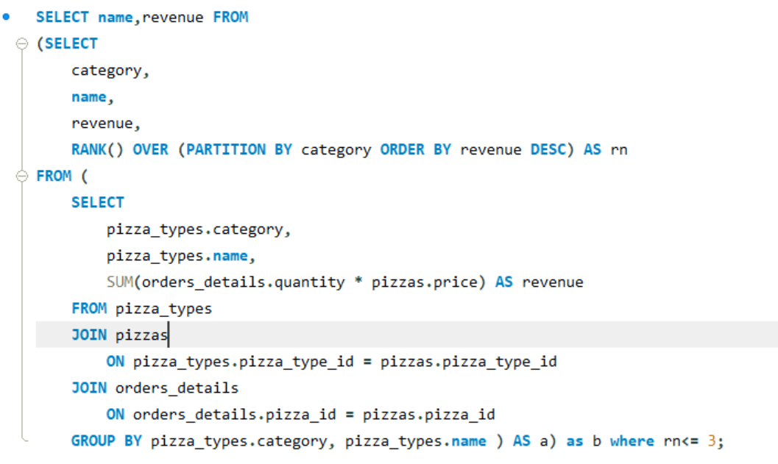
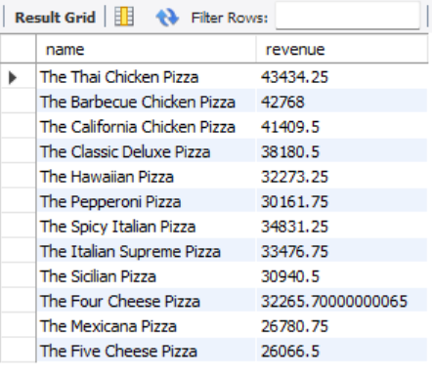
Determine the top 3 most ordered pizza types based on revenue for each pizza category.

Slide 23
THANK YOU

